Slide 1
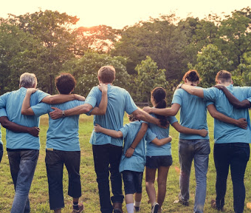
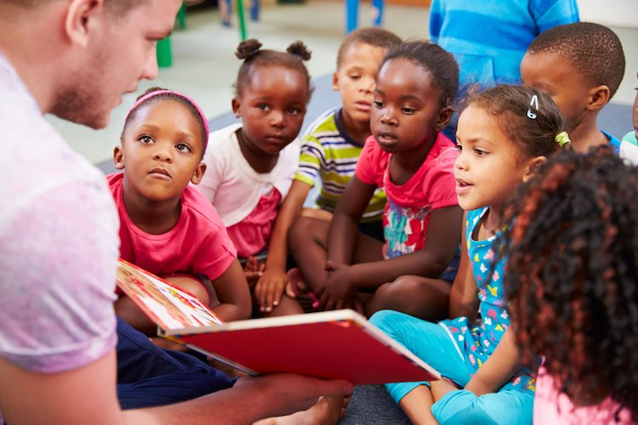
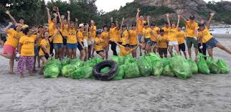
Conversation class
Christopher BAUMAN

Slide 2
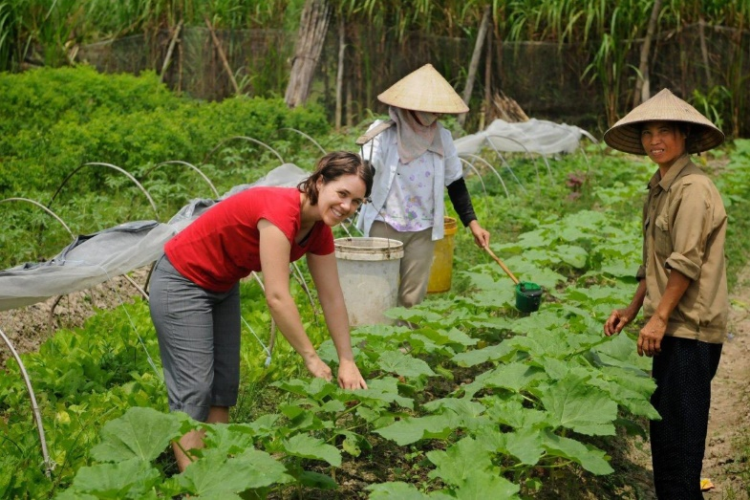
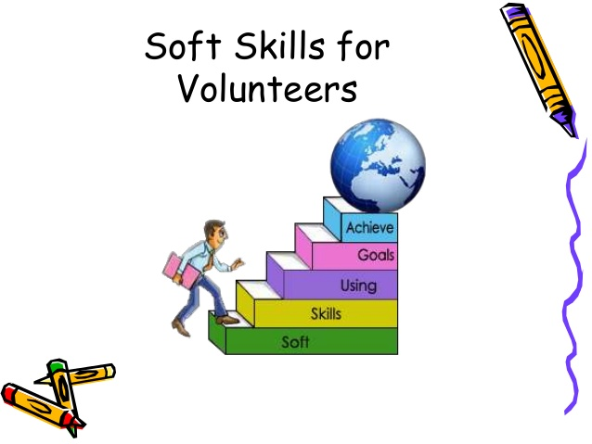
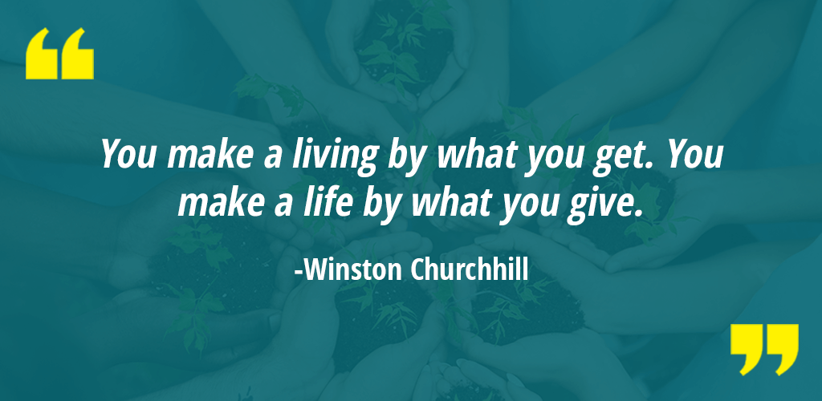
Education Infographic
Travel - https://youtu.be/hl1ZMz9THjg
Altruistic action
Give back
Donate
Time
Caring
Love
Like minded people
Natural disaster
https://youtu.be/l9l9e4hXNXI

